Slide 1
SUMMER INTERNSHIP
BY
BVN AISHWARYA
ROLL NO: 221810309012
CSE B-9

Slide 2
MINI-PROJECT
Make a Heart Disease Predictive Model to predict on the “target” column of the dataset.
Steps to complete:
Specify the architecture.
Compile the model
Fit the model
Predict on sample data.

Slide 3

MINI-PROJECT CERTIFICATE

Slide 4
MAJOR PROJECT
Build a Neural Network, to classify “mask” and “without_mask” images.
Using opencv,predict on each image in a webcam video (whether it is belong to “mask” or “without_mask” image).Round a rectangle on the detected face and also put a text above that rectangle ,depicting whether it is a masked or a non-masked image.

Slide 5

INTERNSHIP CERTIFICATE

Slide 6

WHAT IS ARTIFICIAL INTELLIGENCE?
Artificial Intelligence is the simulation of human intelligence by machines.
The ability to solve the problems.
The ability to act rationally.
The ability to act like humans.

Slide 7
ARTIFICIAL INTELIIGENCE
TYPES
MACHINE LEARNING
DEEP LEARNING

Slide 8
MACHINE LEARNING
Machine learning is defined as a set of tools to make inferences and predictions from the data
HOW DOES IT WORK ?
Interdisciplinary mix of statistics and computer science.
Ability to learn without being explicitly programmed.
Learn patterns from existing data and applies it to new data.
Relies on high-quality data.
TYPES OF MACHINE LEARNING
Supervised Learning
Unsupervised learning
Reinforcement learning

Slide 9
MACHINE LEARNING MODEL
A statistical representation of a real-world process on data
Model
New Input
Outcome

Slide 10
MACHINE LEARNING WORKFLOW
RAW DATA
Test dataset
1.Extract features
2. Split dataset
Train dataset
3.Train model
4.Evaluate

Slide 11
STEPS IN BUILDING MODEL
Extract features
Choosing features and manipulating the dataset.
Split dataset
Train and test dataset.
Train the model
Input train dataset into a machine learning model.
Evaluate
If desired performance isn’t reached : tune the model and repeat Step 3

Slide 12
SUPERVISED LEARNING:
Training data is “labelled”.
Training data consists of features and target columns.
UNSUPERVISED LEARNING:
Training data is not “labelled”.
Training data consists of features only.
REINFORCEMENT LEARNING:
It is a feedback-based machine learning technique in which an agent learns to behave in an environment by performing the actions and seeing the results of actions.
For each good action , the agent gets positive feedback and for each bad action the agent gets negative feedback.

Slide 13
SUPERVISED LEARNING TECHNIQUES
There are two types of supervised techniques:
Classification
Regression
Classification Technique:
The target column has finite set of possibilities.
Example -> Dice roll ,Gender etc.
Regression technique:
The target column has infinite set of possibilities.
Example -> Temperature

Slide 14
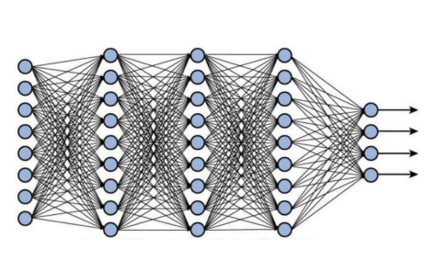
DEEP LEARNING
In neural networks the basic unit are neurons.
Neural networks are much larger.
Deep Learning → Neural network with many neurons.
Can solve complex problems
The simple neural network predict images in terms of positions.
We have three types of layers
Input layer
Hidden layer
Output layer

Slide 15
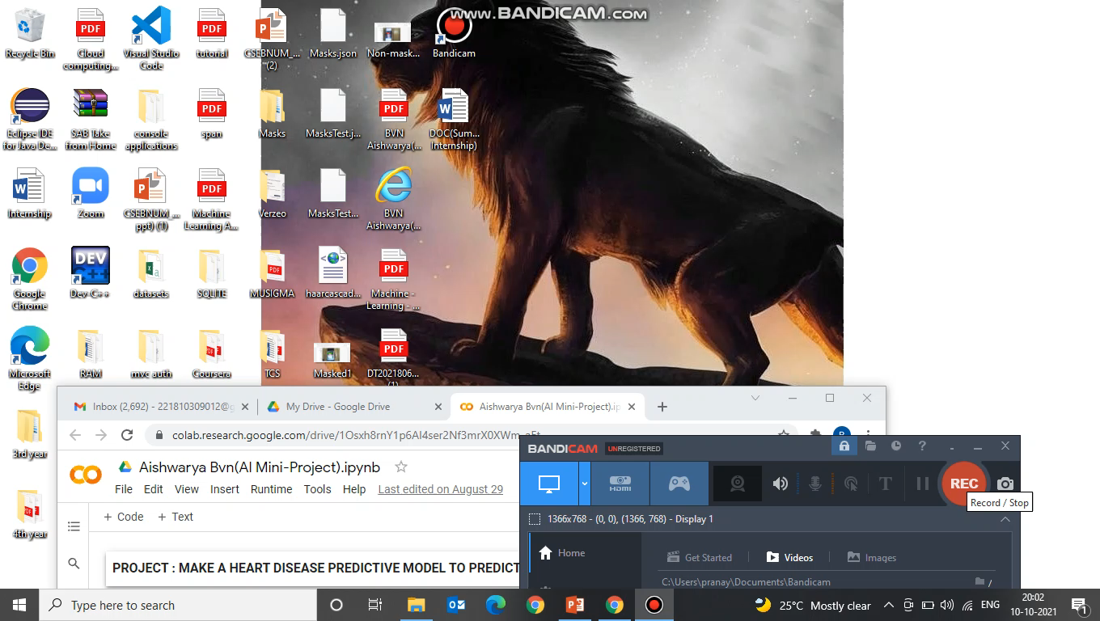
MINI PROJECT CODE

Slide 16
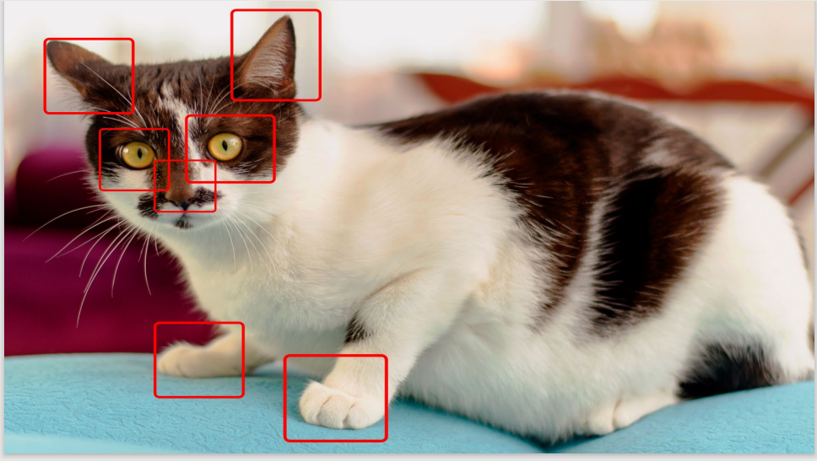
WHEN TO USE DEEP LEARNING?
Lots of data
Access to processing power.
Lack of domain knowledge
Complex problems
Computer vision

Slide 17
CONVOLUTION NEURAL NETWORK
CNN is a class of neural network that specializes in processing data that has a grid like topology such as image.
Convolution neural networks are distinguished from other neural networks by their superior performance with image , speech or audio signal inputs.
CNN predicts the objects in images based on edges of objects.
There are three main types of layers in CNN.
Convolution Layer
Pooling Layer
Fully-connected Layer.

Slide 18
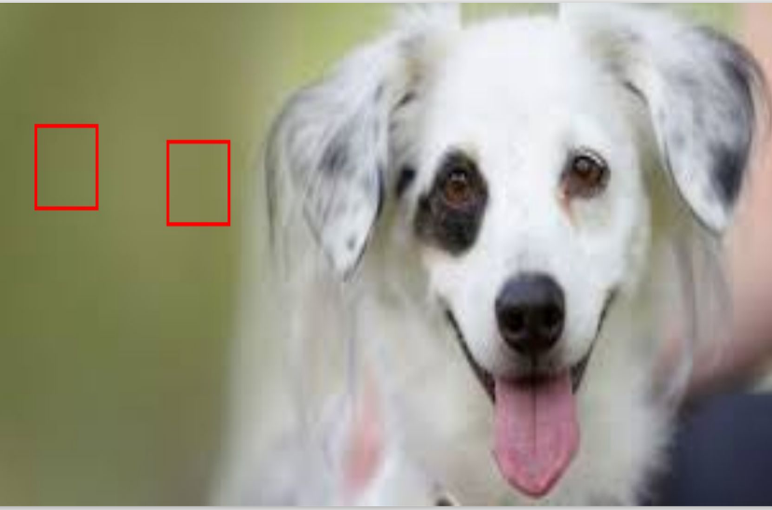
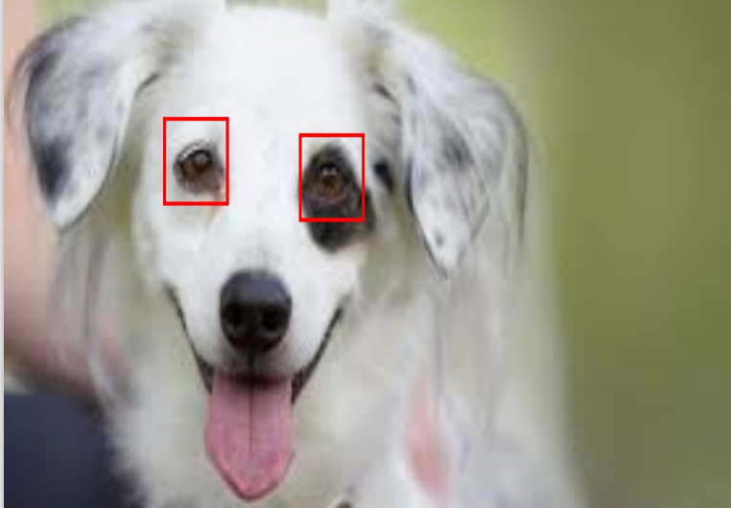
Simple Neural Network
Convolution Neural Network

Slide 19
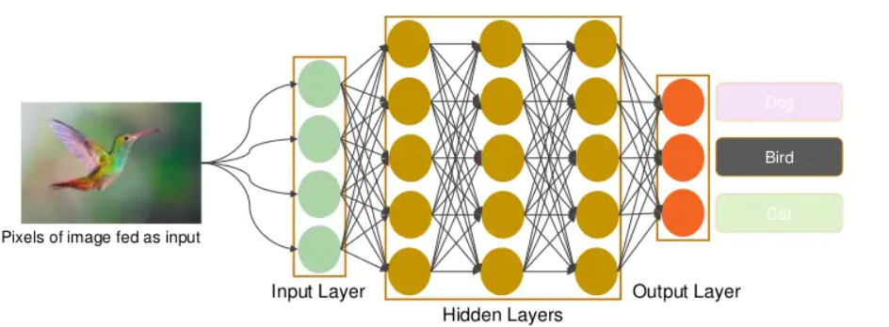
ARCHITECTURE OF CNN

Slide 20
CONVOLUTION LAYER
This layer is the first layer that is used to extract the various features from the input layer.
We divide all the pixel values with 255 to make computation fast.
We obtain values in terms of 0 and 1.
We use multiple convolution filters or kernels that run over the image and compute a dot product.
Each filter extracts different features from the image.
Let us consider a filter size of 3*3 and an image of size 5*5.
We perform an element wise multiplication between the image pixel values that match the size of kernel and the kernel itself and sum them up.
This provides us a single value for the feature cell.

Slide 21


WHAT ARE CONVOLUTIONS?

Slide 22
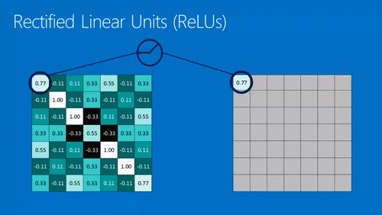

ReLU
Following each convolution operation, the CNN applies a Rectified Linear Unit (ReLU) transformation to the convolved feature, in order to introduce nonlinearity into the model. The ReLU function, F(x)=max(0,x), returns x for all values of x > 0, and returns 0 for all values of x ≤ 0.

Slide 23
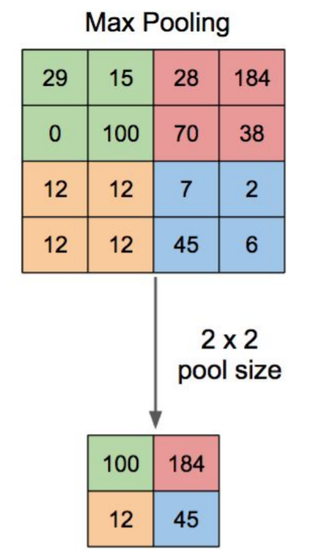
MAX POOLING
Max pooling layer helps reduce the spatial size of the convolved features and also helps reduce over-fitting by providing an abstracted representation of them. It is a sample-based discretization process.
It is similar to the convolution layer but instead of taking a dot product between the input and the kernel we take the max of the region from the input overlapped by the kernel.

Slide 24
FULLY CONNECTED LAYERS
At the end of a convolutional neural network are one or more fully connected layers (when two layers are "fully connected," every node in the first layer is connected to every node in the second layer).
Their job is to perform classification based on the features extracted by the convolutions.
Typically, the final fully connected layer contains a softmax activation function, which outputs a probability value from 0 to 1 for each of the classification labels the model is trying to predict.

Slide 25

MAJOR PROJECT CODE

Slide 26
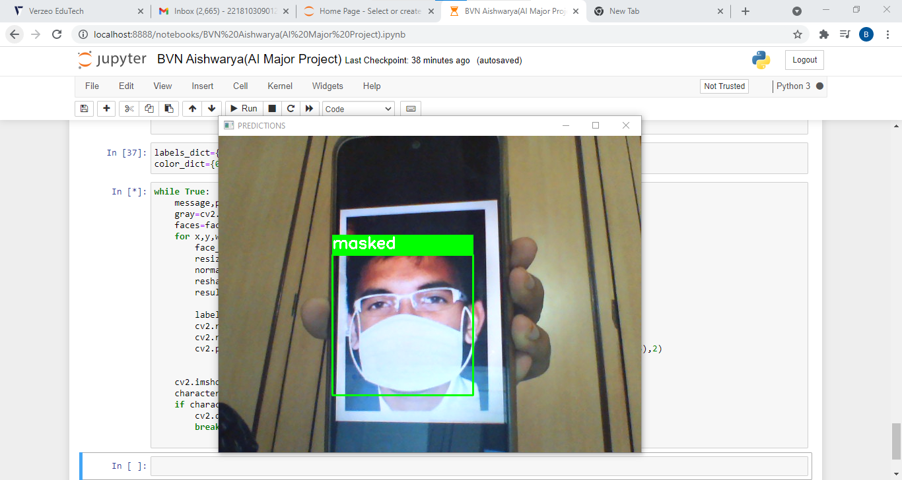

Slide 27
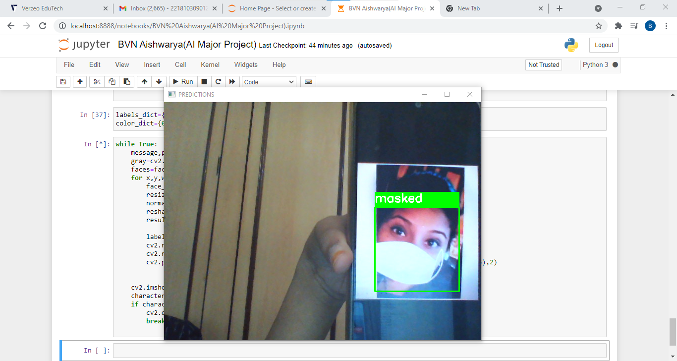

Slide 28
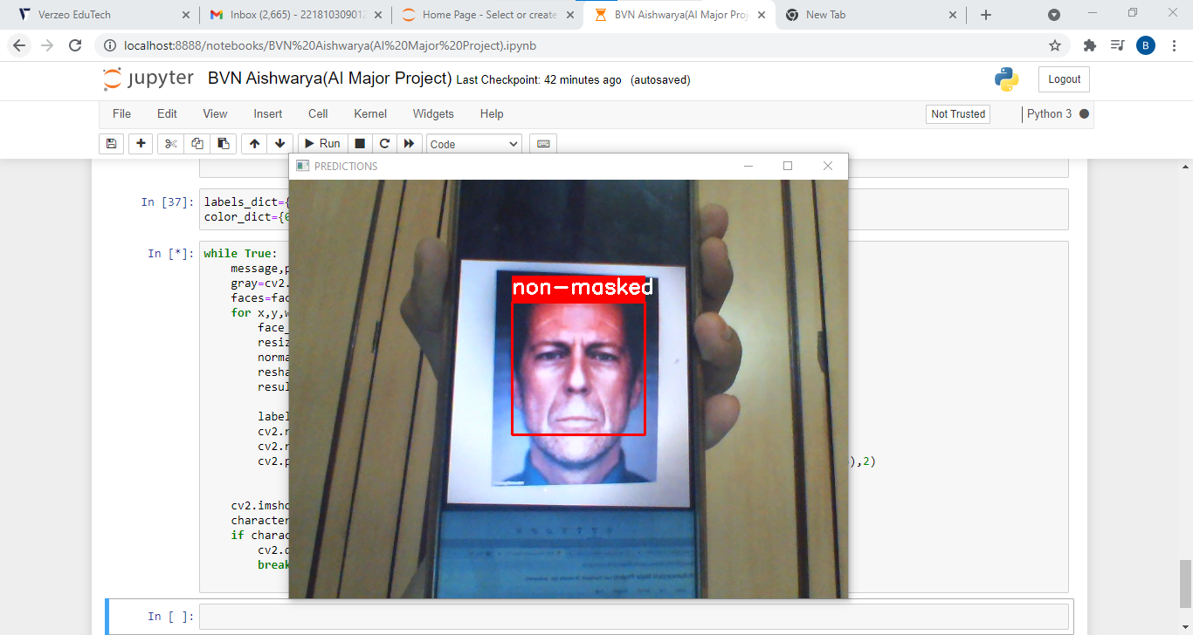

Slide 29
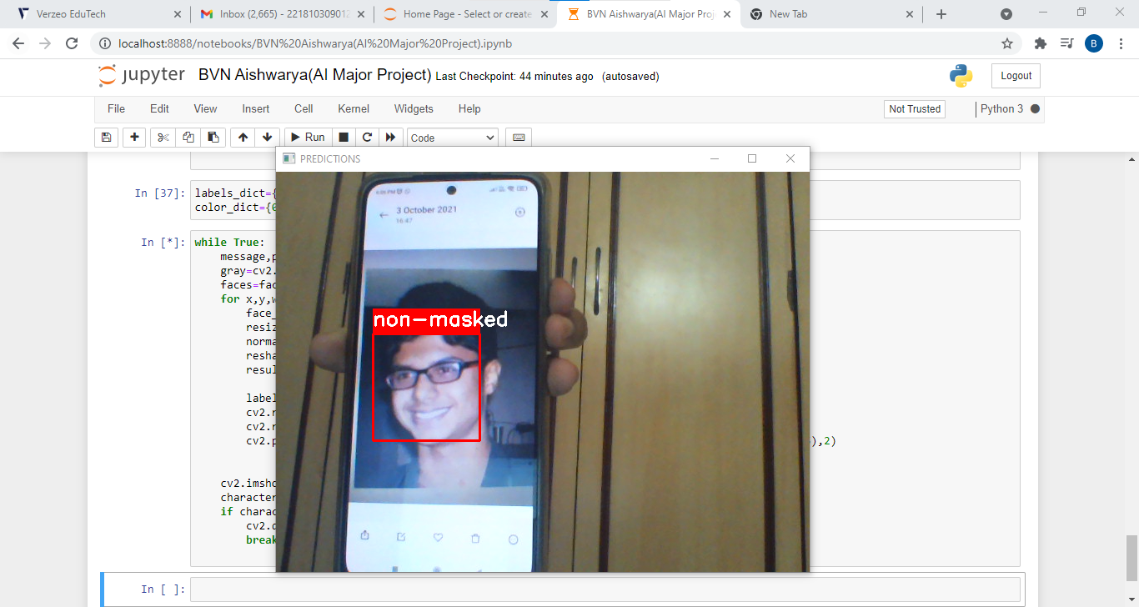

Slide 30
THANK YOU

